Slide 1
Microsoft PowerPoint 2021
Presented by Manal Asghar

Slide 2
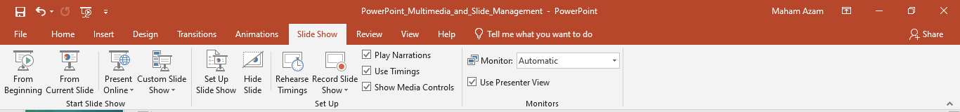
Multimedia & Slide Management in PowerPoint
Insert videos
Screen recording
Export as video
Slide control

Slide 3
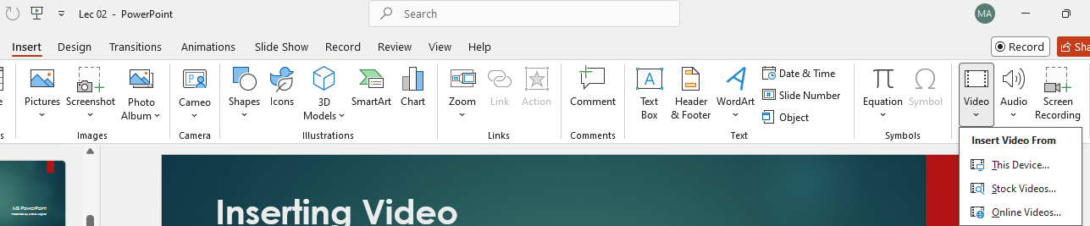
Inserting Video
Go to Insert > Video
Choose Video on My PC or Online Video
Resize and position on slide
Playback options in ‘Playback’ tab
Choose Video
Go to Insert
My PC or Online Video

Slide 4
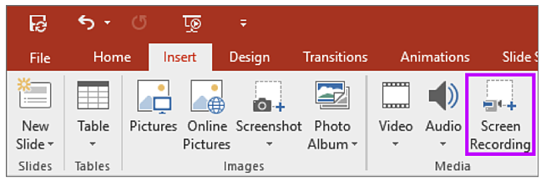
Screen Recording
Insert > Screen Recording
Select screen area
Click Record
Use stop shortcut (Windows + Shift + Q)
Recording is inserted automatically
Click here for screen recording

Slide 5
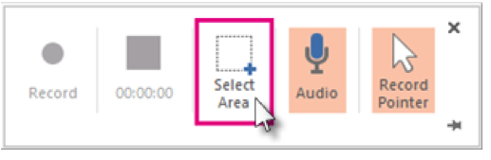
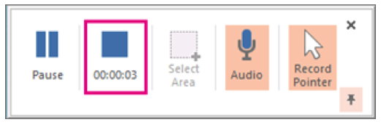
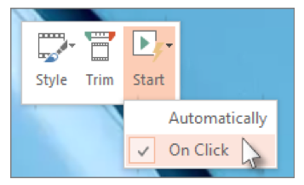
Click here for screen recording
Start recording

Slide 6
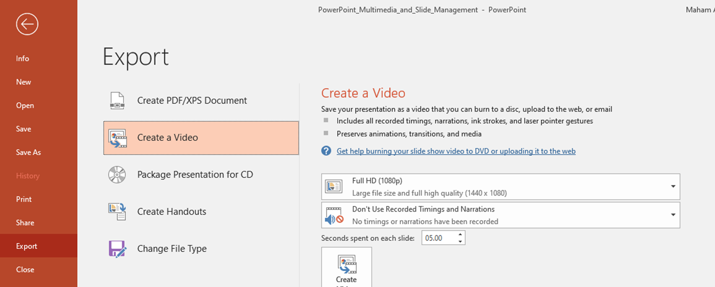
Convert PPT to Video
File > Export > Create a Video
Choose quality and timings
Click ‘Create Video’ and save as .mp4

Slide 7
Saving Screen Recording
Right-click the recording on the slide
Select ‘Save Media as…’
Choose file name and location

Slide 8
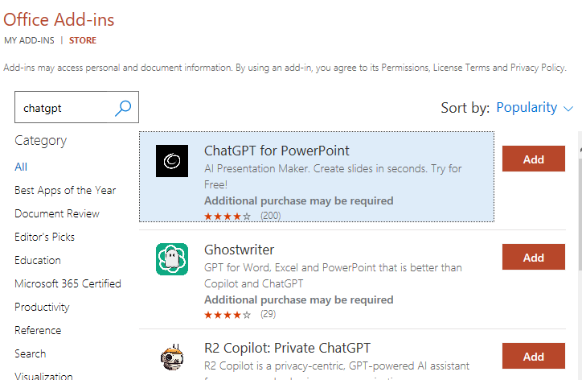
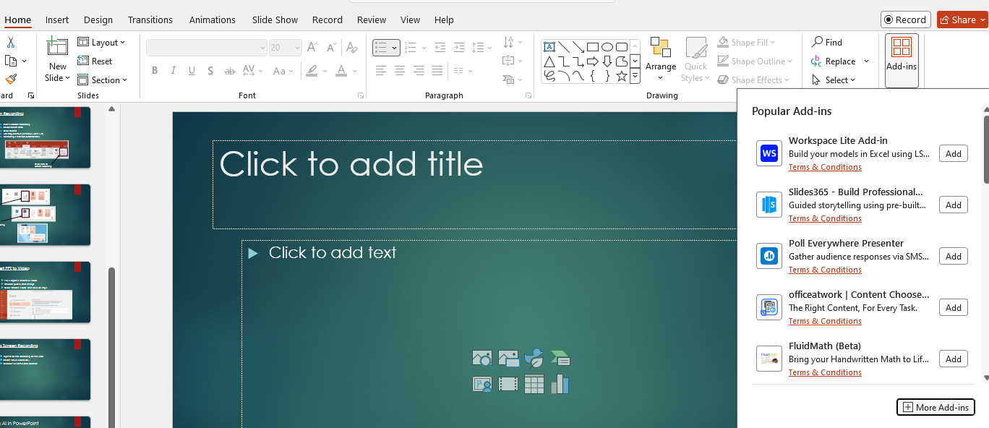
Using AI in PowerPoint
Click on Home tab
Click on
Add-ins
Type here
Click add
Click on
More Add-ins

